Slide 1
Site Translation
TheSkyX
Site
Targeting
Target
Web
Query
Results Parsing
RA/Dec
CNEOS Scout
Web API
Query Manager
MPC Manager
Ephemeris
Tracking
dRA/dDec

Slide 2
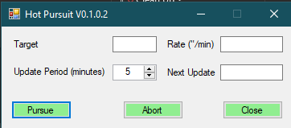

Slide 3
Pursue
CNEOS
Scout
Get Target Name
TheSky64
Get Nearest Observatory
Site Translation
Load Ephemeris
Sub-minute Interpolation
Reload
Iterate Tracking Changes
Abort

Slide 4











Site
MPC Observatory
$$S$$
$$M$$
R_{e}
N
$$∆Dec$$
$$∆Lat$$
B
C
$∆Dec= {Dec}_{M}−{Dec}_{G}$
$$∆Lat={Lat}_{M} −{Dec}_{G}$$
$$DistanceCN=DistanceNB+DistanceBC$$
$$DistanceBC= Re∗Cos\left(∆Lat\right)$$
$$Tan ∆Dec=\frac{{Distance}_{SB}}{{Distance}_{NB}}$$
$${Distance}_{NB}=\frac{{Distance}_{SB}}{Tan\left(∆Dec\right)}$$
$$↔$$
$${Distance}_{CN}=\left(\frac{{Distance}_{SB}}{Tan\left(∆Dec\right)}\right)+ Re∗Cos\left(∆Lat\right)$$
$${∆Dec}_{S}=\tan^{−1}\left(\left(R_{e}×\sin\left({Lat}_{s}\right)\right)/\left({Distance}_{CN}−\left(R_{e}×\cos\left({Lat}_{S}\right)\right)\right) \right)$$

